Slide 1


Backpacking or Travel?
Using Naïve Bayes Model and Random Forest Classifier to classify subreddit posts

Slide 2

Agenda
Problem Statement
Data Background
Exploratory Data Analysis
Modeling Process and Results
Takeaways and Recommendation

Slide 3
Problem Statement
An unfortunate power outage on some Reddit servers has caused some posts (from r/backpacking and r/travel) to be stored incorrectly within the servers
As an employee of Reddit, my supervisor has tasked me to correctly reclassify these posts by training classifier models to solve this issue
We will be training the models based on about 2000 reddit posts (about 1000 posts from each subreddit)

Slide 4
Data Background
Pushshift API
100 posts per requests
Removed any duplicated posts
Cleaning
Dropped 6 rows containing missing values
Checked that there are also no mod bot messages
Removed posts containing ‘[removed]’ (2 rows)
Lowercased all words and removed hyperlinks, white spaces, numbers
Preprocessing
Lemmatize words (days -> day, nights -> night)
Added to stop words: ‘backpacking’, ‘travel’ plus other generic words
r/backpacking (cleaned)
993 posts
Combined
2038 posts
r/travel
(cleaned)
1045 posts

Slide 5
Exploratory Data Analysis
r/backpacking
r/travel
832 unique users
1.19 post per user
Longest post by word count: 7,493 words (trip report)
Shortest post by word count: 6 words (title of an image)
Most common Bigram and trigrams
969 unique users
1.08 post per user
Longest post by word count: 2,535 words (covid restriction discussion while traveling)
Shortest post by word count: 3 words
(user replying via post to thank someone)
Most common Bigram and trigrams

Slide 6
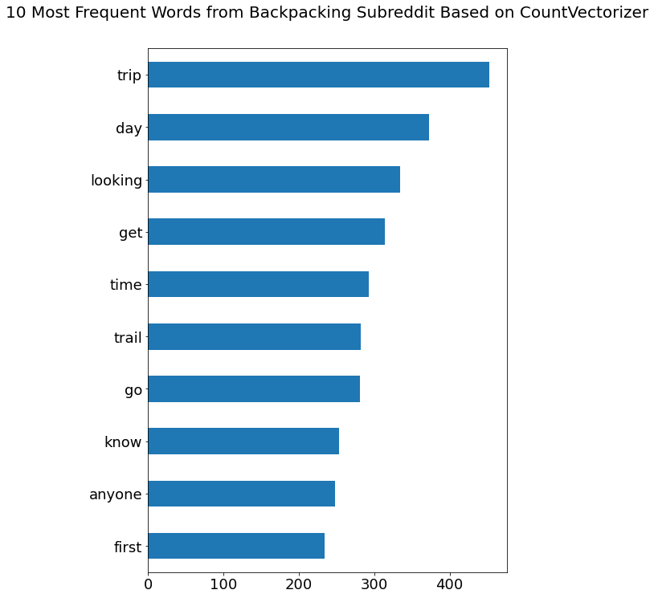
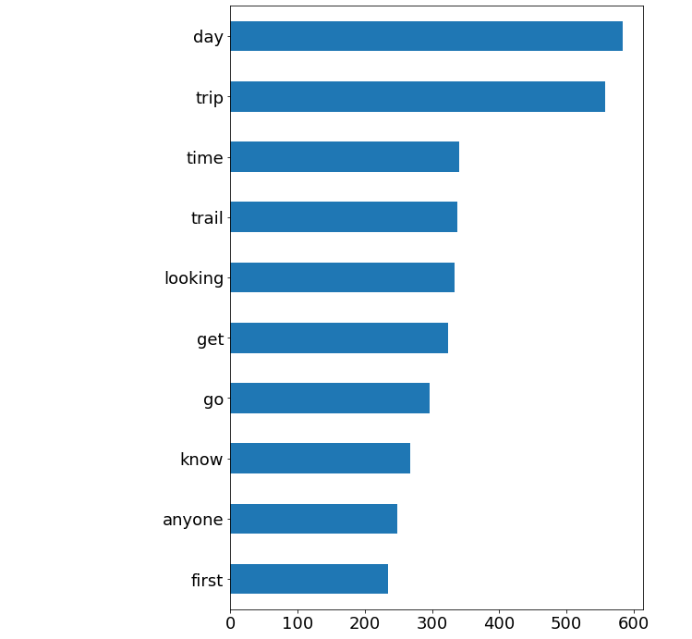
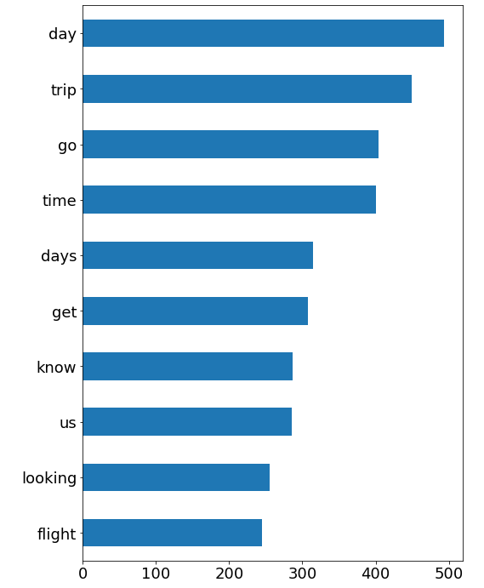
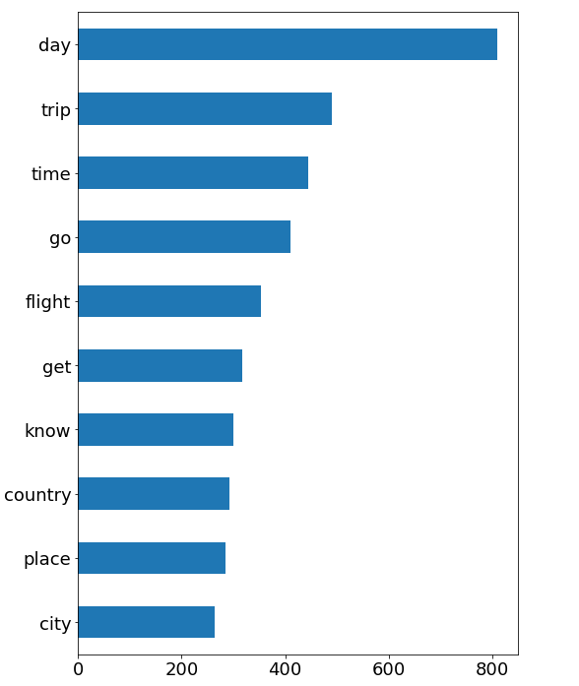
Exploratory Data Analysis
10 most frequent words using CountVectorizer
r/backpacking
r/travel
w/o lemmatize
w/ lemmatize
w/o lemmatize
w/ lemmatize

Slide 7
Modeling Process and Results
Train test split: stratify y, setting a random state to rerun models
Fit and run models using Pipeline and GridSearchCV:
2 models: Naïve Bayes and Random Forest
Baseline for each model is the default hyperparameters using CountVectorizer
Naïve Bayes
Tf – IDF Vectorizer
GridSearch best hyperparameters:
'nb__alpha’: 0.5
'tvec__max_features’: 7000
'tvec__ngram_range': (1, 2)
Train score: 0.8494
Test score: 0.8216
Random Forest
Tf – IDF Vectorizer
GridSearch best params:
'rf__max_depth': None
'rf__n_estimators': 200
'tvec__max_features': 10000
'tvec__ngram_range': (1, 3)
Train score: 0.8220
Test score: 0.8098
Notes:
Adding too many stop words would start to reduce the score:
adding in trip, day, time, go, get, looking, anyone, know, first
These are top frequent words for both subreddits
Adding words that are typically misclassified into our stopwords
Interesting observation: adding these words improve scores for models on Tfidf but not for countvectorizer
Is it optimal? I believe so, did a number of rounds to fine tune the hyperparamters via gridsearch
How is your model doing badly?

Slide 8
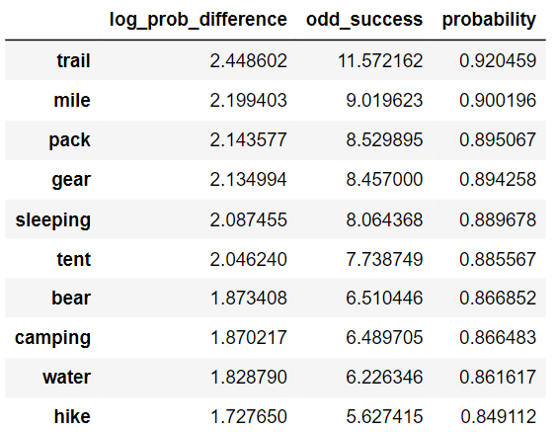
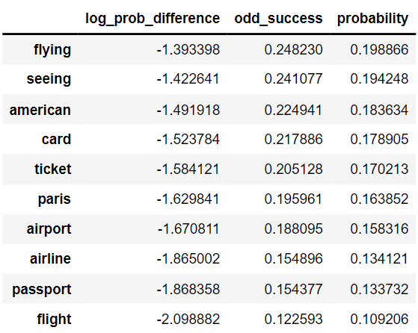
Modeling Process and Results Feature importance of Naïve Bayes
Top 10 word contributors to differentiate backpacking post from travel post
Bottom 10 word contributors to differentiate backpacking post from travel post

Slide 9
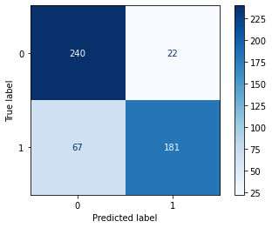
Misclassification Analysis on Best Model: Naïve Bayes
TN
FP
FN
TP
Accuracy score: 82.16%
Subreddit:
0: Backpacking
1: Travel
False positives: posts that incorrectly classified as backpacking
False positives: posts that incorrectly classified as travel
Most misclassified posts were long posts
Average word count: 97 words
The longest post being 721 words
The most common words were: day, trip, time, go, get

Slide 10
Takeaways and Recommendations
For the 2 subreddits: Naïve Bayes marginally performs better than Random Forest.
Surprisingly, the concern for the naïve assumption that all features are independent has minimal impact to the model’s capability to classify the reddit posts accurately
Naïve Bayes or Random Forest?
Naïve Bayes | Random Forest
Good: Easy to train and understand the results It has different extensions for different needs Computes faster | Good: Random forest method works for all types of data {numeric, cardinal, ordinal}
Bad: Assumes all variables are uncorrelated but generally not true | Bad: Takes time to train and consumes more time to predict proportional to the number of trees (computationally more expensive)
Notes:
https://www.quora.com/When-and-why-is-a-naive-Bayes-classifier-a-better-worse-choice-than-a-random-forest-classifier
https://www.quora.com/Under-which-conditions-might-somebody-prefer-applying-Naive-Bayes-than-Random-Forest-in-a-classification-problem
In short, if you don’t want to sweat a lot in research, but want to build a classifier model with reasonable performance; go for random forest method. If you want to get a quick and dirty but very fast model, and when the features are known to be independent of each other; go for Naive Bayes model.
In terms of potential commercial applications, we could train this model for a company like tripadvisor which relies heavily on getting accurate post trip reviews for a customer’s decision making process
This classifier could be adapted to remove spam or fictitious review messages from a hotel’s review section
Within the industry, it is not uncommon for hotel owners to push their staff to write reviews to boost their ranking on tripadvisors

